Slide 1

Pacific People Partners
(Thailand) Co., Ltd.
People First.
Purpose Driven.
Parity Always.
AI-Powered HR Management Transformation
AI赋能HR管理变革
U.S.-style HR, workforce and technology-enabled labor solutions for companies operating in Thailand.
面向泰国运营企业的美式HR、劳动力与技术赋能用工解决方案。
To make every person's value seen, respected, and amplified.
让每个人的价值被看见、被尊重、被放大。
Company Profile | HR Services | AI + People Management System
公司介绍 | HR服务 | AI+People管理系统

Slide 2

PACIFIC PEOPLE PARTNERS
PPP connects global standards with Thailand execution
PPP连接国际标准与泰国本地执行
Pacific People Partners is a Thailand-based HR and workforce solutions partner for Chinese, U.S. and international companies operating in Thailand.
Pacific People Partners 是立足泰国的人力资源与劳动力解决方案伙伴，服务在泰运营的中资、美资及国际企业。
U.S.-style governance
美式治理标准
Thailand local execution
泰国本地执行
Clear standards, disciplined delivery and accountable service management.
清晰标准、规范交付、责任明确的服务管理。
Factory-side support, multilingual communication and local labor coordination.
驻厂支持、多语言沟通、本地劳动事务协调。
People-centered compliance
以人为本的合规
Technology-enabled HR
技术赋能HR
Labor compliance is the baseline; dignity and fairness are the operating method.
劳动合规是底线，尊严与公平是方法。
AI dashboards, workflow tracking and reports improve visibility and speed.
AI看板、流程追踪与报告提升透明度和响应速度。
People First. Purpose Driven. Parity Always.
02

Slide 3
PACIFIC PEOPLE PARTNERS
Culture gives the operating system its purpose
文化为运营系统赋予方向
People First. Purpose Driven. Parity Always.
Our culture sets the standard for how we recruit, manage, communicate and solve workforce problems.
我们的文化决定我们如何招聘、管理、沟通并解决用工问题。
People First
以人为先
Purpose Driven
使命驱动
Parity Always
平等准则
Clear communication, timely support and fair treatment.
清楚沟通、及时支持、公平对待。
Every service solves a real business and human problem.
每项服务都解决真实的企业与人的问题。
Equal respect and standards across nationality, role and background.
跨国籍、岗位、背景的平等尊重与标准。
Vision / 愿景
A fairer and smarter labor ecosystem where every person has equal access to meaningful work.
建设更公平、更智能的劳动生态，让每个人都能平等获得有尊严、有意义的工作机会。
People First. Purpose Driven. Parity Always.
03

Slide 4

PACIFIC PEOPLE PARTNERS
Technology must serve people, not replace people
技术必须服务于人，而不是替代人
主动拥抱AI与具身机器人时代，是为了让人的价值被更清楚地看见、更公平地尊重、更高效地放大。
We embrace AI and embodied robotics to make human value more visible, more respected, and more amplified.
PPP believes technology should serve people, not replace people.
AI reveals workforce signals. Robotics can absorb repetitive or risky tasks. People move toward safer, higher-value work.
文化定位 / Cultural Positioning
AI与具身机器人不是独立于企业文化之外的技术项目，而是PPP践行以人为先、以使命为驱动、以平等为准则的工具。
AI and embodied robotics are not separate technology projects. They help PPP practice People First, Purpose Driven and Parity Always in a visible and scalable way.
People First. Purpose Driven. Parity Always.
04

Slide 5
PACIFIC PEOPLE PARTNERS
AI and robotics extend the Three Ps into the future of work
AI与机器人让三个P走向未来工作
People First / 以人为先
AI与机器人不是人的替代者，而是人的能力放大器。技术承担重复、危险、低效的环节，让人走向更安全、更有价值的岗位。
AI and robotics are not replacements for people. They amplify human capability by taking on repetitive, risky and inefficient work so people can move toward safer, higher-value roles.
Purpose Driven / 以使命为驱动
我们不为技术而技术。每一次AI系统、自动化流程和具身机器人方案，都必须服务于效率、合规、员工体验和稳定运营。
We do not adopt technology for its own sake. Every AI workflow, automation process and robotics solution must improve efficiency, compliance, employee experience and operational reliability.
Parity Always / 以平等为准则
技术不能制造新的不平等。不同国籍、岗位、语言和教育背景的员工，都应获得清晰指引、培训机会和数字化支持。
Technology must not create new inequality. Employees across nationalities, roles, languages and education levels should receive clear guidance, training opportunities and digital support.
People First. Intelligence Forward. / 以人为本，向智能而行。
People First. Purpose Driven. Parity Always.
05

Slide 6
PACIFIC PEOPLE PARTNERS
A full-service workforce platform for Thailand operations
面向泰国运营的全链条劳动力服务平台
HR Consulting
HR咨询
Talent & Executive Search
人才招聘与猎头
Employer setup, HR systems and compliance routines.
雇主设立、HR制度与合规机制。
Thai hiring, bilingual talent and management recruitment.
泰籍招聘、双语人才与管理岗招聘。
EOR, Payroll & Compliance
EOR薪酬合规
Staffing & Workforce
派遣与劳动力管理
Employment support, payroll, social security and PIT.
雇佣支持、薪酬、社保与个税。
Thai and Myanmar workforce recruitment and deployment.
泰劳与缅工招聘、派遣与管理。
On-site HR & Factory Support
驻厂HR支持
AI + People Management
AI+People管理
Resident HR, interpreters, labor relations and case handling.
驻厂HR、翻译、劳资关系与个案处理。
Dashboards, workflows, alerts and AI reports.
看板、流程、预警与AI报告。
IT / Technical / Data Outsourcing
IT/技术/数据外包
Embodied Robotics Workforce
具身机器人劳动力
International IT, technical service and data operations.
国际IT、技术服务与数据采集运营。
Human-robot planning, operator staffing and deployment.
人机协同规划、操作员配置与部署支持。
People First. Purpose Driven. Parity Always.
06

Slide 7
PACIFIC PEOPLE PARTNERS
AI + People Management System turns HR service into visible operations
AI+People管理系统让HR服务可视化运营
The system connects clients, employees and PPP delivery teams in one platform, giving managers a live view of workforce status, compliance risk and service progress.
系统连接客户、员工与PPP交付团队，让管理者实时看到人员状态、合规风险与服务进度。
Workforce Dashboard
劳动力看板
Recruitment Pipeline
招聘流程
Attendance & Shift
考勤排班
Payroll Status
薪酬状态
Compliance Alerts
合规预警
Document Workflow
文件流程
AI HR Assistant
AI HR助手
Multilingual Support
多语言支持
The value is not software alone. It is AI-enabled visibility combined with PPP's people-side execution.
价值不只是软件，而是AI可视化能力与PPP线下人员服务能力的结合。
People First. Purpose Driven. Parity Always.
07

Slide 8
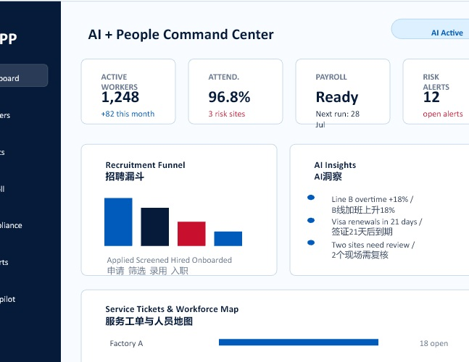
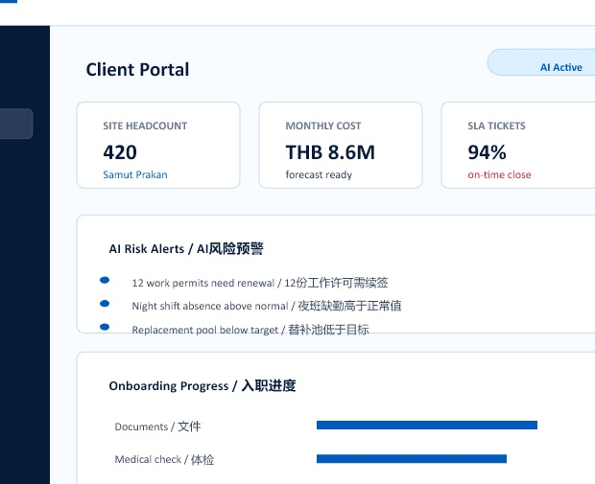
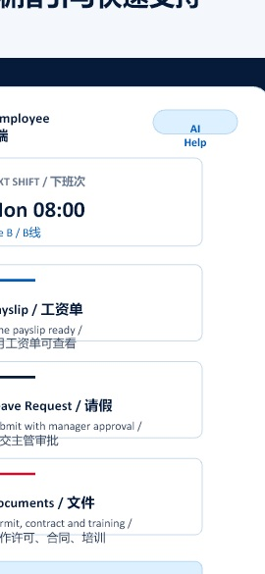
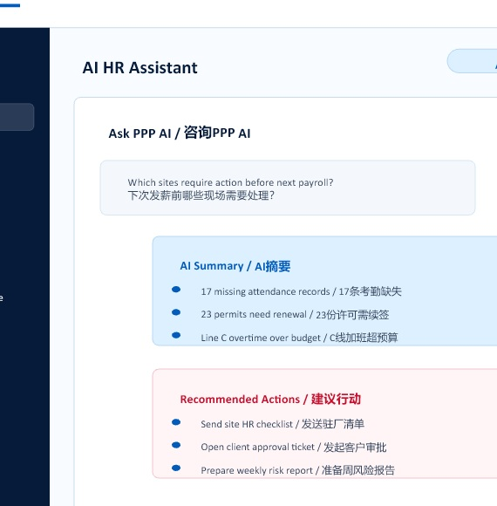
AI + People system connects every workforce view
AI+People系统把劳动力管理整合到同一视图
PACIFIC PEOPLE PARTNERS
Full view shows workforce health, cost and risk in one place
全视图集中呈现人员健康度、成本与风险
One operating layer links clients, workers, PPP delivery teams and AI assistance.
Managers can see status, cost, risk and next actions without separating data from daily service.
一个运营层连接客户、员工、PPP交付团队与AI助手，让管理者在同一页看到状态、成本、风险和下一步动作。
PPP
AI Active
Full workforce view / 全景视图
Client service view / 客户视图
Dashboard
ACTIVE WORKERS
ATTEND.
PAYROLL
RISK ALERTS
1,248
96.8%
Ready
08
Workers
+82 this month
3 risk sites
Next run: 28 Jul
open alerts
Clients
Recruitment Funnel
招聘漏斗
AI Insights
AI洞察
Payroll
Line B overtime +18% / B线加班上升18%
Compliance
Visa renewals in 21 days / 签证21天后到期
Employee view / 员工端
AI next-action assistant / AI行动助手
Two sites need review / 2个现场需复核
Reports
Applied Screened Hired Onboarded
申请 筛选 录用 入职
AI Copilot
Service Tickets & Workforce Map
服务工单与人员地图
Factory A
18 open
Factory B
15 open
Logistics Hub
12 open
Service Center
9 open
Outcome: fewer blind spots, faster responses and more transparent HR operations.
结果：减少管理盲区、提升响应速度、让HR服务更透明。
People First. Purpose Driven. Parity Always.
08

Slide 9

PACIFIC PEOPLE PARTNERS
Embodied robotics expands the workforce conversation
具身机器人扩展劳动力方案边界
PPP treats robotics as a workforce design issue, not only an equipment purchase. The goal is a human-robot operating model that improves productivity while keeping people at the center.
PPP把机器人视为劳动力设计问题，而不只是设备采购问题。目标是建立以人为中心、提升效率的人机协同运营模式。
Workforce planning
劳动力规划
Human-robot workflow
人机协同流程
Map tasks, shifts and headcount before robotics deployment.
部署前梳理任务、班次和人员变化。
Define roles, handoffs, safety routines and supervisor checkpoints.
明确岗位、交接、安全流程和主管检查点。
Operator staffing and training
操作员配置与培训
Deployment coordination
部署协调
Recruit or assign operators, trainers and maintenance coordinators.
招聘或配置操作员、培训员和维护协调角色。
Support change management, on-site adoption and productivity reports.
支持变革管理、现场导入与效率报告。
People First. Purpose Driven. Parity Always.
09

Slide 10

PACIFIC PEOPLE PARTNERS
Recruitment combines local market access with cross-border discipline
招聘结合本地市场能力与跨境交付纪律
Thai workforce recruitment / 泰籍员工招聘
Bilingual talent for Chinese, English and Thai environments / 中英泰工作环境双语人才
Executive search for management and technical roles / 管理与技术岗位猎头
Screening, interview, onboarding and replacement support / 筛选、面试、入职与替换支持
The hiring promise / 招聘承诺
Every search should protect both the client's operating needs and the candidate's dignity.
每一次招聘都应同时保护客户的运营需求与候选人的尊严。
People First. Purpose Driven. Parity Always.
10

Slide 11
PACIFIC PEOPLE PARTNERS
Staffing is managed as an operating service, not a transaction
派遣与外包用工是运营服务，不是一次性交易
Volume hiring
批量招聘
Workforce deployment
人员派驻
Pipeline design, screening and planned deployment.
招聘流程设计、候选人筛选与计划派驻。
Onboarding, attendance, shifts and replacement pool management.
入职、考勤、排班与替补池管理。
Retention support
稳定性支持
Management reporting
管理报告
Employee communication, escalation and on-site service routines.
员工沟通、问题升级和驻厂服务机制。
Headcount, attendance, cost, SLA and compliance dashboards.
人数、考勤、成本、SLA与合规看板。
For manufacturing and logistics clients, the service model is built around continuity, visibility and fast issue resolution.
面向制造与物流客户，服务模型围绕连续性、可视化与快速问题解决建立。
People First. Purpose Driven. Parity Always.
11

Slide 12
PACIFIC PEOPLE PARTNERS
EOR and payroll support reduce friction for Thailand teams
EOR与薪酬服务降低泰国团队运营摩擦
Employer of Record support / 名义雇主EOR支持
Payroll, payslip and payment workflow / 薪酬、工资单与付款流程
Social security and PIT coordination / 社保与个人所得税协调
Employment documents and compliance records / 雇佣文件与合规记录
Reports aligning cost, headcount and service status / 成本、人数与服务状态报告
Compliance is the baseline. The differentiator is making employment operations clear, predictable and human.
合规是底线，差异化在于让雇佣运营清晰、可预期且有人情味。
People First. Purpose Driven. Parity Always.
12

Slide 13

PACIFIC PEOPLE PARTNERS
Migrant workforce and on-site HR require disciplined daily management
外籍劳工与驻厂HR需要有纪律的日常管理
Myanmar workforce support
缅工支持
Work permit and visa process
工作许可与签证
Recruitment, staffing, documents and employee communication.
招聘、派遣管理、文件协调与员工沟通。
Process tracking, document readiness and renewal reminders.
流程追踪、文件准备与续签提醒。
Resident HR and interpreters
驻厂HR与翻译
Labor relations and cases
劳资关系与个案
On-site presence for communication, attendance, training and issues.
现场沟通、考勤、培训与问题处理。
Accident coordination, insurance, discipline and dispute support.
事故、保险、纪律与争议协调。
People First. Purpose Driven. Parity Always.
13

Slide 14
PACIFIC PEOPLE PARTNERS
PPP is built for companies scaling operations in Thailand
PPP服务在泰国扩张运营的企业
Chinese-invested manufacturers
中资制造企业
U.S. and international companies
美资及国际企业
Industrial parks and export factories
工业园与出口工厂
Logistics and warehousing operators
物流与仓储企业
Technology and service teams
技术与服务团队
Robotics-enabled operations
机器人赋能运营
The common need is the same: reliable people operations, local compliance and management visibility.
共同需求是一致的：可靠的人力运营、本地合规与管理可视化。
People First. Purpose Driven. Parity Always.
14

Slide 15
Let's build a fairer, smarter and more productive workforce together.
让我们一起建设更公平、更智能、更高效的劳动力生态。
People First. Purpose Driven. Parity Always.
以人为先，以使命为驱动，以平等为准则。
Pacific People Partners (Thailand) Co., Ltd.
Mobile: 0986630666
Email: frank.feng@ppp.blue
Website: www.ppp.blue
Address: 2122/11-15 Srinagarindra Rd, Thepharak, Mueang Samut Prakan District, Samut Prakan 10270 ,Thailand

